Slide 1

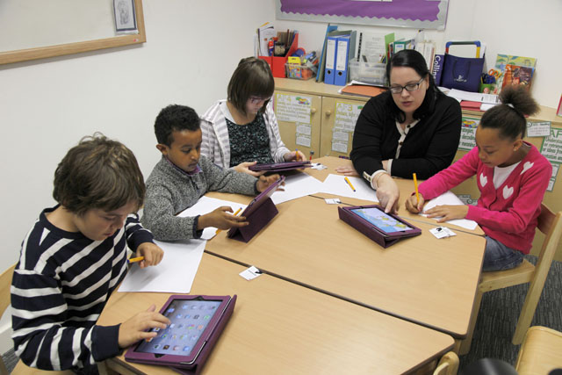
Small group primary workshops
Slides to support sessions 1-8
Achievement for All (3As) Ltd 23b Kingfisher Court Hambridge Road Newbury RG14 5SJ (UK) e: marius.frank@afaeducation.org

Slide 2
Being safe and responsible online
Session 2

Slide 3
Protection from Harassment Act 1997
Malicious Communications Act1988
Communications Act 2003
Obscene Publications Act 1959
Public Order Act 1986
Computer Misuse Act 1990
Health and Safety at Work Act 1974
Laws that can deal with bullying online

Slide 4
Being safe and responsible online
Session 3

Slide 5
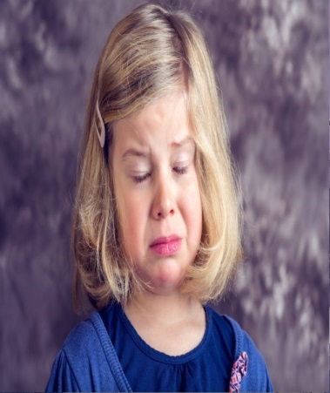
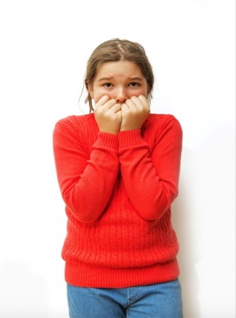
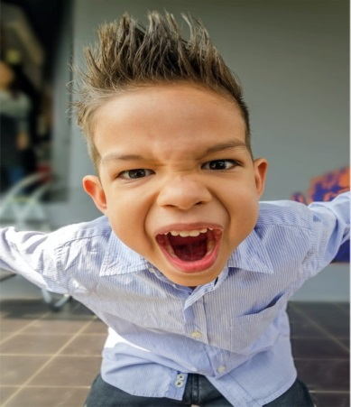
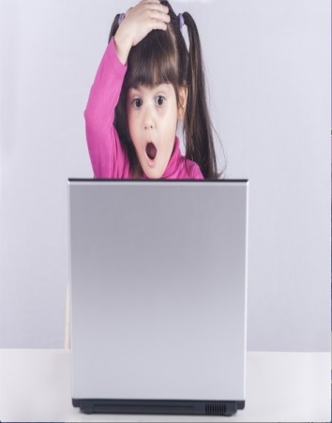
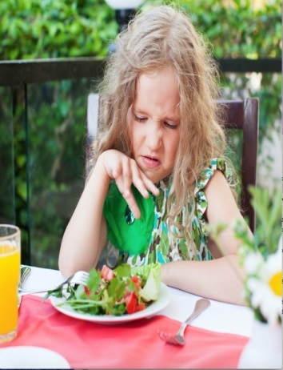
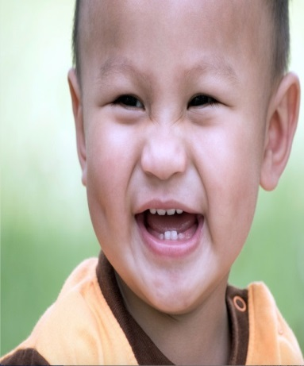
Can you recognise the emotion?
Distress
Fear
Anger
Surprise
Disgust
Joy
We all have emotions
They are essential for our survival

Slide 6
Distress
Fear
Anger
Surprise
Disgust
Joy
How can these emotions be shown online?

Slide 7
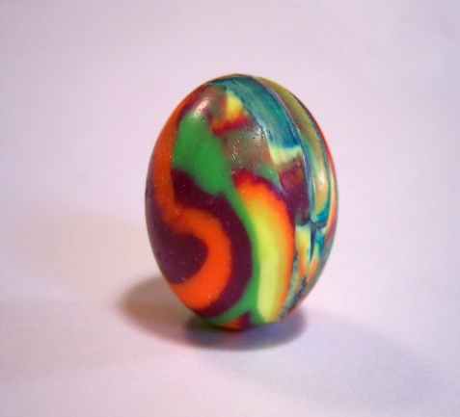
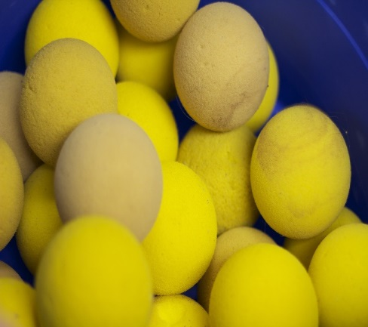
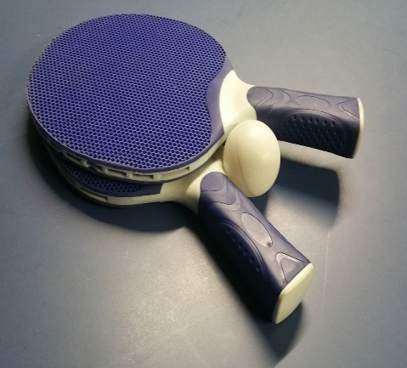
What is Resilience?
Which ball do you think is the most resilient? Why?
A rubber ball?
A foam ball?
A ping pong ball?

Slide 8
Resilience is not about trying to be ‘so tough’ that nothing impacts us. Resilience is not about putting up with things.
Resilience is the ability to recover from setbacks. It is OK to feel sad, angry, happy, worried…it is how we respond and adapt that is key.

Slide 9
Digital Resilience
Digital resilience
is the ability to bounce back from difficult times online over time

Slide 10


Create a Digital Resilience Toolbox
Think of 1 idea for each of the areas to help improve your digital resilience

Slide 11
Being safe and responsible online
Session 4

Slide 12
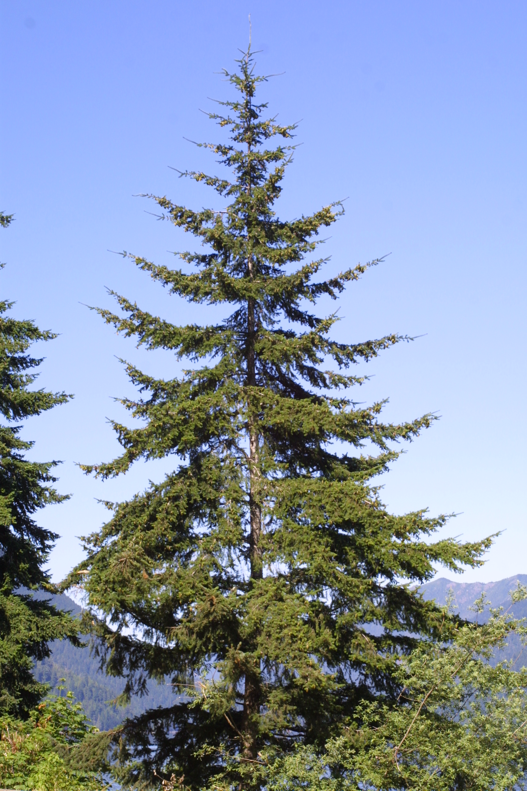
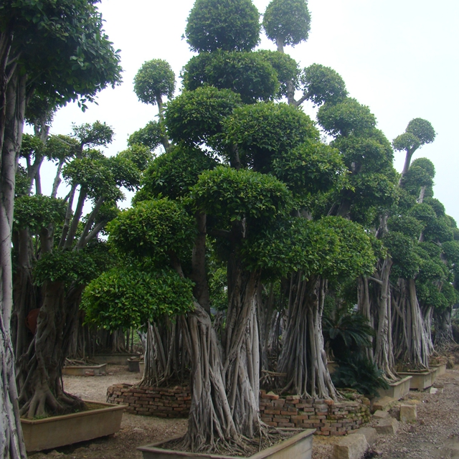
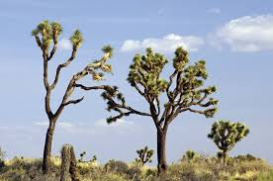
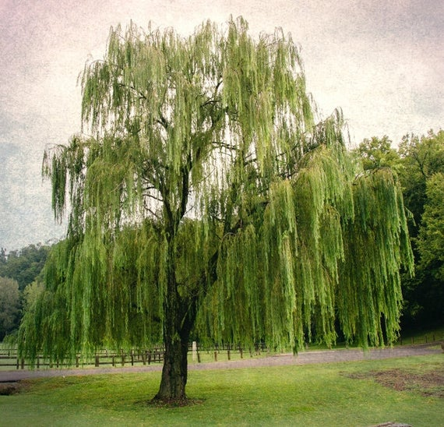
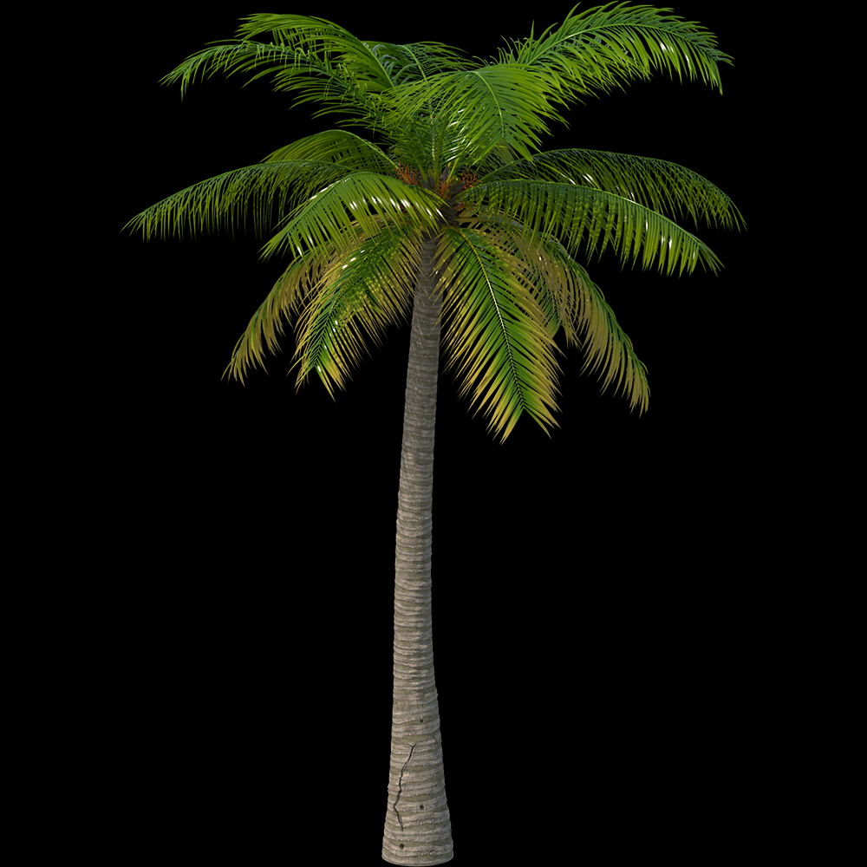
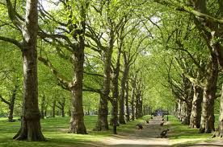
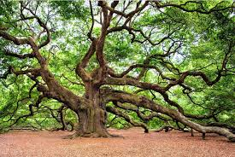
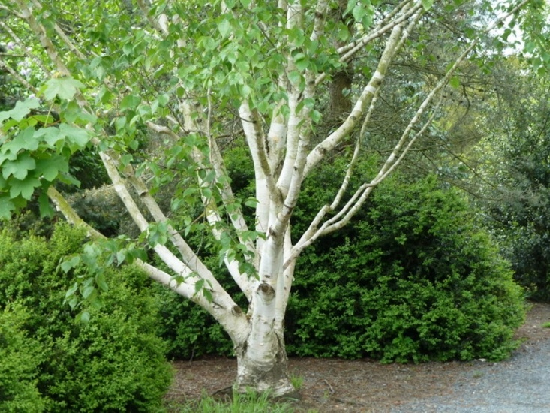

Slide 13
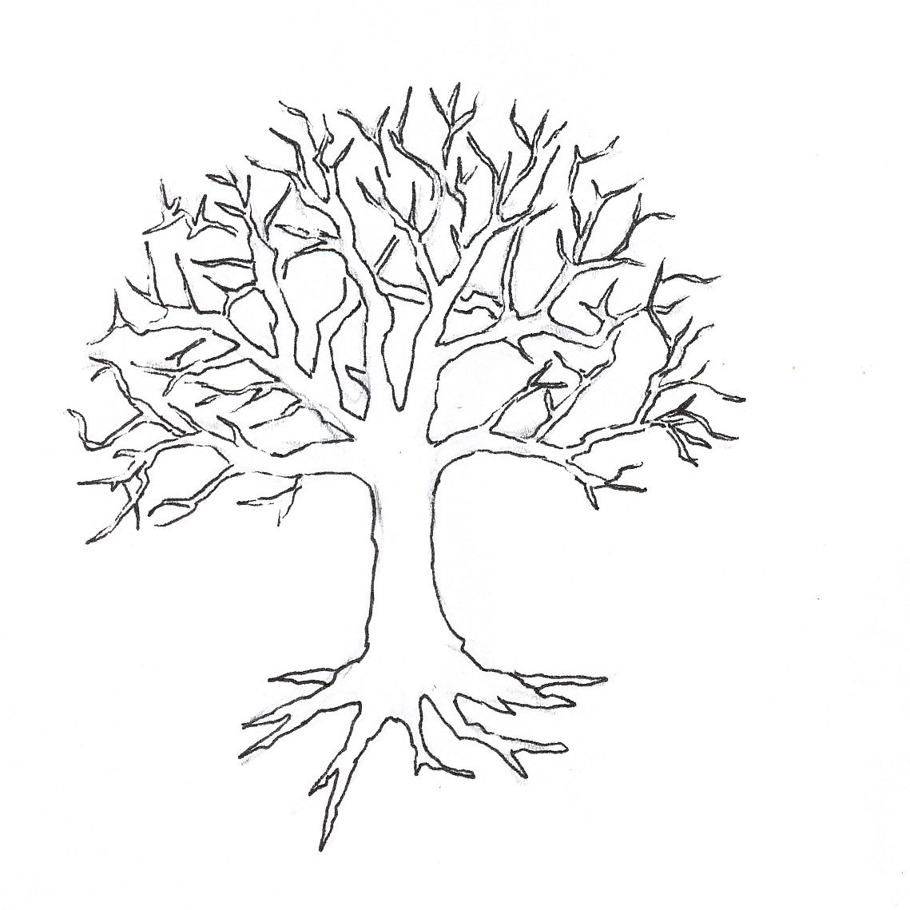
Branches: what you want to achieve in next few years.
Trunk: the resources you have within yourself (strengths, skills, qualities) and other people you can turn to for support
Roots: where you come from. Places, people, events that have been important in your past
Branches
Trunk
Roots

Slide 14
Being safe and responsible online
Session 5

Slide 15
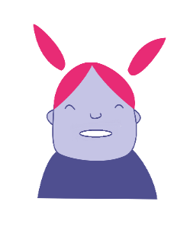
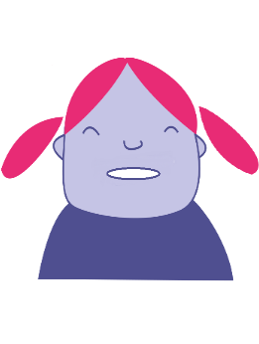
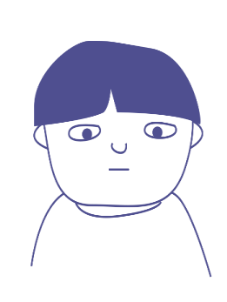
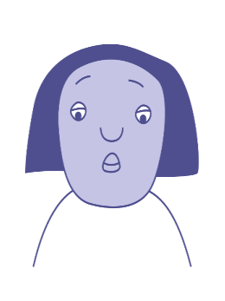
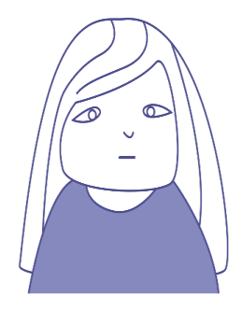
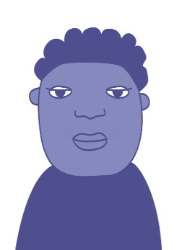
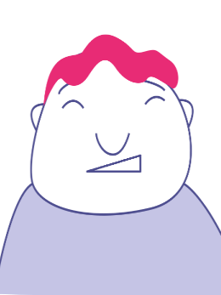



Bullying as a group behaviour
Ringleader
Target
Reinforcer
Outsider
Defender
Assistant

Slide 16
Being safe and responsible online
Session 7

Slide 17
Values we might want to share
Democracy people vote for the people who make the laws and decide how the country is run
The rule of law a police force and courts to prosecute people who break the law to keep people and their property safe.
Individual liberty as long as they do not break the law, people can live as they choose and have their own values and opinions
Mutual respect people try to show respect for other’s thoughts and feelings even when they might not always agree with them
Tolerance of those of different faiths and beliefs people accept that other people might have different beliefs and religions

Slide 18
Democracy, Rule of law, Liberty, Respect, Tolerance.
What would you add to these values?
What should we do to preserve these values?
How do people challenge these values online?

Slide 19
Extremists
An extremist strongly supports a certain idea or cause in a way that most people find unreasonable.
They may use these views to justify hateful or harmful behaviour towards those they oppose or who oppose them

Slide 20
To justify violence, extremists might say…..
“It’s time to get revenge for what they’ve done to us.”
“Life will be better without them.”
“We need people like you.”
“No one is listening, we have to take action.”
“We have to defend ourselves.”
“They are to blame.”
“We know how you feel.”

Slide 21
Checking views for bias
Check other websites to see if they say the same thing
Check the facts - some websites may be presenting a biassed view by presenting opinions as facts e.g. they may be representing the views of a political group that has a particular view
If you have been contacted directly on social media, what aspect of your online presence or activity (such as, a video you've watched, a game you've played, an item you've bought) may have triggered this contact?
Look carefully at who is contacting you. Do you know them? What do they know about you? Are they addressing you directly or could it be a 'bot'?
Think why websites are using particular images and words – why did they create and publish them – what feelings would they like readers to feel ?

Slide 22
Being safe and responsible online
Session 8

Slide 23
What next?
Which statements on your Policy have you put into action?
How well did they work?
How did you feel when they did work?
How have your online relationships improved?
How confident are you in your ability to use technology and the internet safely?
How confident are you in your family's online safety?

Slide 24
My action plan
How will you do this?
When will you do this?
What will be the benefits of doing this?
What will be the barriers to doing this?
How will you feel when you do this?
How will others help and how will they know that you have done it?

